Slide 1
Rainfall Prediction using GAN
Created by
A . Harini
3rd year CSE
Reg no: 912321104008
SACS MAVMM engineering college

Slide 2
Project outline:
Problem statement
Proposed system/solution
System development approach
Algorithm and deployment
Result
conclusion

Slide 3
Problem Statement:
Develop a Generative Adversarial Network (GAN) model to predict rainfall patterns accurately based on historical weather data. The model should be able to generate realistic future rainfall sequences given past meteorological conditions, aiding in better forecasting and planning for agriculture, water resource management, disaster preparedness, and other sectors dependent on weather patterns.

Slide 4
Proposed system/solution:
Data Collection:
Gather historical rainfall data from various sources such as weather stations, satellites, or meteorological databases.
Data Preprocessing:
Clean the data, handle missing values, and preprocess it for compatibility with GAN architecture.
GAN Architecture:
Design a GAN architecture suitable for generating realistic rainfall predictions.
Training:
Train the GAN using historical rainfall data.

Slide 5
Proposed solution(contd…):
5.Evaluation:
Validate the trained GAN using various metrics such as accuracy, precision, recall, or through visual inspection of generated rainfall patterns.
6.Deployment:
Deploy the trained GAN model to predict future rainfall patterns based on input meteorological conditions such as temperature, humidity, and atmospheric pressure.
7.Continuous Improvement:
Periodically retrain the GAN using updated data to improve prediction accuracy and adapt to changing weather patterns.

Slide 6
System Development Approach:
Hardware Requirements:
1.High-performance Computing (HPC) Cluster or GPU Server:
GANs are computationally intensive, especially during training. Therefore, you would require hardware capable of handling large-scale parallel computations efficiently.
Options include GPU servers equipped with NVIDIA Tesla or AMD Radeon Instinct GPUs, or utilizing cloud-based services like AWS EC2 with GPU instances or Google Cloud Platform's Compute Engine with GPU support.

Slide 7
Hardware requirement(contd…)
2. Storage Infrastructure:
Large datasets of historical weather data need to be stored and managed. A scalable storage solution like network-attached storage (NAS) or cloud-based object storage (e.g., Amazon S3, Google Cloud Storage) is necessary.
Additionally, provision for storing generated model checkpoints and intermediate results during training is essential.
3. Networking Infrastructure:
Fast networking infrastructure is crucial for data transfer between storage, compute resources, and potentially, for distributed training setups if applicable.

Slide 8
Software Development Approach:
Data Collection and Preprocessing:
Gather historical rainfall data from various sources such as weather stations, satellites, or meteorological agencies.
Preprocess the data to handle missing values, outliers, and ensure uniformity in formats.
GAN Model Architecture:
Design the GAN architecture tailored for rainfall prediction. This includes:
Explore different GAN variants (e.g., DCGAN, WGAN, etc.) and architectures suitable for the problem domain.

Slide 9
Software requirement(contd…)
3. Training Pipeline:
Implement a training pipeline to train the GAN model on the collected and preprocessed rainfall data.
Utilize frameworks like TensorFlow, PyTorch, or Keras for model development and training.
Experiment with hyperparameter tuning, learning rate schedules, and regularization techniques to enhance model performance and stability.
4. Validation and Evaluation:
Validate the trained GAN model using validation datasets and standard evaluation metrics for rainfall prediction tasks, such as Mean Squared Error (MSE), Root Mean Squared Error (RMSE), or Correlation Coefficient.
Perform thorough testing to assess the model's generalization capability and robustness across different geographical regions and time periods.

Slide 10
5. Deployment and Integration:
Integrate the trained GAN model into an application or service for real-time or batch prediction of rainfall.
Develop APIs or interfaces for seamless integration with other systems or applications.
Ensure scalability and reliability of the deployment infrastructure to handle varying prediction loads.
6. Monitoring and Maintenance:
Implement monitoring mechanisms to track model performance, data drift, and potential issues post-deployment.
Regularly update the model with new data and retrain as necessary to maintain its accuracy and relevance.

Slide 11
Algorithm and deployment
Algorithm:
1. Data Preparation:
Collect historical rainfall data from reliable sources.
Consider factors such as geographical location, time of year, temperature, humidity, and atmospheric pressure as features.
2. GAN Architecture:
Design a GAN architecture suitable for generating realistic rainfall predictions.
The generator network takes random noise or conditioning data as input and generates synthetic rainfall data.
Consider using convolutional neural networks (CNNs) or recurrent neural networks (RNNs) as building blocks, depending on the nature of your data.

Slide 12
3 . Training:
Train the GAN using historical rainfall data.
Utilize techniques like mini-batch gradient descent and adaptive learning rate methods.
Monitor convergence and adjust hyperparameters as necessary to avoid mode collapse or instability.
4. Evaluation:
Evaluate the trained GAN using metrics such as the Wasserstein distance, Jensen-Shannon divergence, or visual inspection.
Compare synthetic rainfall predictions with real data to assess the model's accuracy and realism.
Validate the model's generalization capabilities on unseen data to ensure it can make reliable predictions in real-world scenarios.

Slide 13
Deployment:
Model Serialization:
Serialize the trained GAN model to a format suitable for deployment, such as TensorFlow's SavedModel or ONNX.
Include any preprocessing steps required to transform input data into the format expected by the model.
Deployment Environment:
Choose a deployment environment based on factors like scalability, latency requirements, and infrastructure availability.
Options include cloud platforms (e.g., AWS, Azure, Google Cloud), on-premises servers, or edge devices.

Slide 14
3. Model Serving:
Set up a server or cloud function to host the deployed model.
Ensure scalability and fault tolerance to handle varying levels of incoming traffic.
4. Monitoring and Maintenance:
Implement monitoring tools to track the deployed model's performance, such as request latency, error rates, and resource utilization.
Establish automated alerts for detecting anomalies or model degradation.
5. Security and Compliance:
Implement security measures to protect sensitive data and prevent unauthorized access to the deployed system.
Ensure compliance with relevant regulations, such as data privacy laws and industry standards for weather forecasting models.

Slide 15
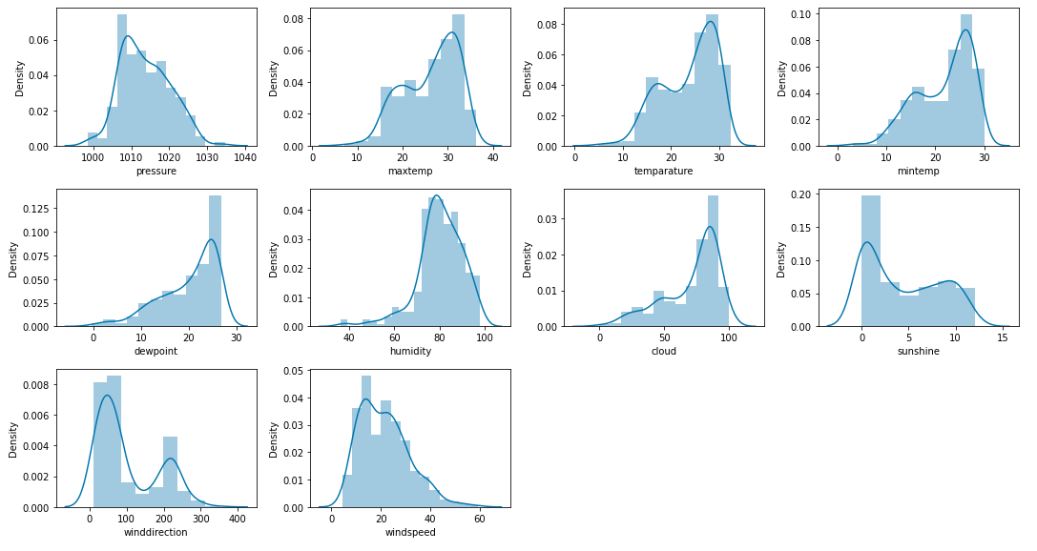
Result:

Slide 16
Conclusion:
The development of a rainfall prediction system using GANs involves a combination of hardware infrastructure provisioning, software development encompassing data processing, model training, validation, deployment, and ongoing maintenance. Collaborating with domain experts in meteorology and utilizing advanced techniques in deep learning and data science will be key to the success of such a project.

Slide 17
Thank you

